Slide 1
Topics
Review
Defining Subqueries
Describing the types of problems Subqueries can solve
Listing types of Subqueries
Writing single row and multiple row Subqueries

Slide 2
Group Functions?
AVG
COUNT
MAX
MIN
SUM
STDDEV
VARIANCE

Slide 3
Review
What is the difference between a where clause and a having clause?
The Where clause filters out rows that don’t meet a search condition
The Having clause filters out entire groups that don’t meet a search condition

Slide 4
Review
How do group functions handle null values?
Min?
Ignore any null values
Avg?
Ignore null values and exclude that row from the row count total divisor

Slide 5
Subqueries
Who earns more money than Wilson?
Who earns more than their manager?
How do you answer these business questions with SQL?

Slide 6
Subqueries
PROBLEM: Who earns more money than Wilson ?
Solution: 2 steps
Find out how much Wilson earns
Find out who earns more than that amount
This requires two queries … but
Writing two separate queries does not accomplish this
We need to pass information from one query into the second query
We need a Subquery to define Wilson’s salary and pass it to the main query that produces the results.

Slide 7
Subqueries
SELECT <select list>
FROM <table>
WHERE <expression> <operator>
(SELECT <select list>
FROM <table>
WHERE <expression> <operator>)

Slide 8
SUBQUERY
Subquery Syntax
A Subquery is a SELECT statement that is imbedded in a clause of another SELECT statement.
Useful when you need to select rows from a table with a condition that depends on data from the same table or other tables
Where are subqueries used?
On the following clauses:
WHERE clause
HAVING clause
FROM clause
Single-row operator < >, =, <,>, etc.
Multiple-row operators IN, ANY, ALL, EXISTS

Slide 9
SUBQUERY
OTHER TERMS USED
Nested SELECT
Sub-SELECT
Inner SELECT
ORDER of OPERATION
The Subquery generally executes first and its output is then the fed to the main or OUTER query

Slide 10
SUBQUERY GUIDELINES
Enclose subquery in parentheses
Place the Subquery on the right side of the comparison operator for readability
You can do it the other way
SELECT * from employees WHERE (select salary from employees where last_name = 'Abel') < salary

Slide 11
SUBQUERY GUIDELINES
ORDER BY clause in the Subquery is only needed when performing TOP-N analysis
Normally the order by clause is only found at the end of the SQL statement.
TOP-N analysis refers to finding the top number of rows.
Example top seven salaries
Use single row operators with single row subqueries
Use multi row operators with multi row subqueries

Slide 12
SUBQUERY TYPES
Single Row Subqueries – returns one row in the “inner” result set
Multi Row Subqueries – returns multiple rows in the “inner” result set
Multi-column Subqueries – returns multiple columns in the “inner” result set

Slide 13

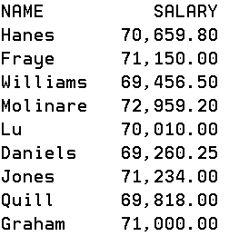
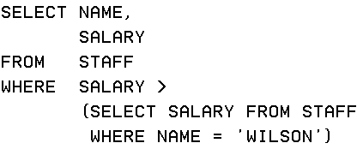
Building a subquery

Slide 14


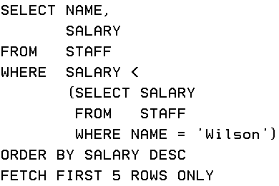
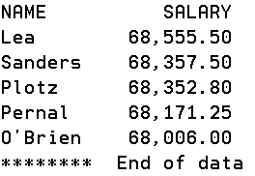
Subqueries

Slide 15
Subqueries – Multi Row Subqueries
What are the minimum salaries for each job and who is the employee
SELECT NAME, JOB, SALARY FROM STAFF
WHERE SALARY =
(SELECT MIN(SALARY) FROM STAFF
GROUP BY JOB)
What’s wrong with the query above?
A GROUP BY implies multiple rows being returned
An = requires a single result set to compare with
You cannot have SALARY = to n different items

Slide 16
Subqueries – Multi Row Subqueries
To use a Subquery that returns more than one row you need to use a Multiple-row operator
IN – Equal to any member in the list
ANY – Compare value to each value returned by the subquery
ALL – Compare value to every value returned by the subquery

Slide 17
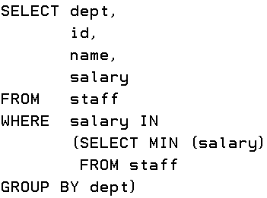
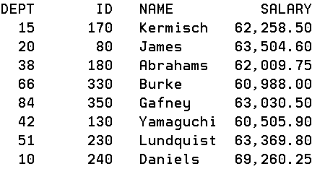
Subqueries – Multi Row Subqueries

Slide 18
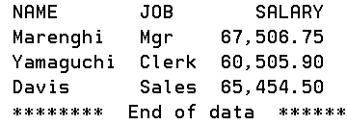
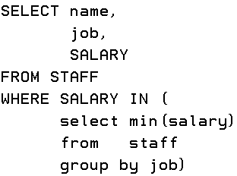
Subqueries – Multi Row Subqueries
PROBLEM: Show me information on the lowest paid employee for each job category

Slide 19
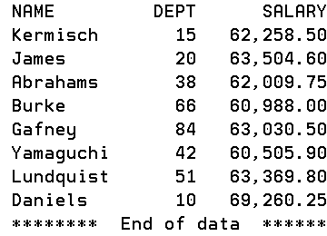
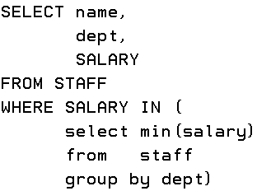
Subqueries – Multi Row Subqueries
PROBLEM: Show me information on the lowest paid employee in each department

Slide 20
Subqueries – Multi Row Subqueries
The ANY operator is a logical operator that compares a value with a set of values returned by a subquery.
The ANY operator must be preceded by a comparison operator >, >=, <, <=, =, <> and followed by a subquery.
X = ANY (…) The values in column c must match one or more values in the set to evaluate to true.
X > ANY (…) The values in column c must be greater than the smallest value in the set to evaluate to true.
X < ANY (…) The values in column c must be smaller than the biggest value in the set to evaluate to true.
X <> ANY (…) The values in column c must not match one or more values in the set to evaluate to true.

Slide 21
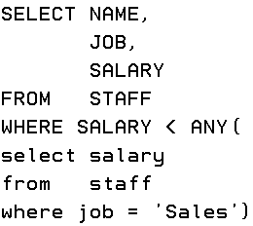
Subqueries – Multi Row Subqueries
PROBLEM: Display employees with a salary less than people with sales job

Slide 22
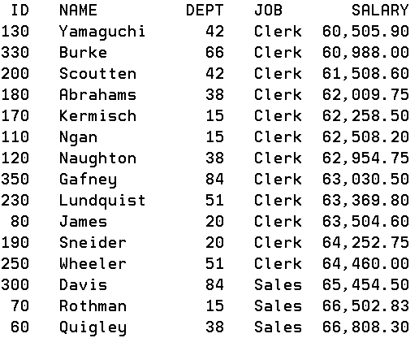
Subqueries – Multi Row Subqueries
It makes more business sense to remove sales jobs from the result set

Slide 23
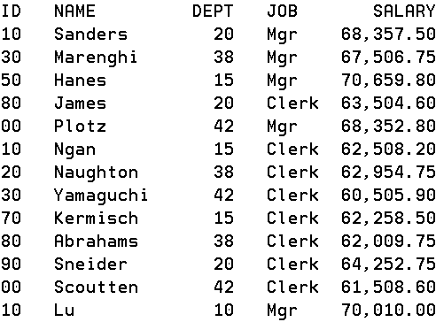
Subqueries – Multi Row Subqueries
No Sales people in our result set

Slide 24
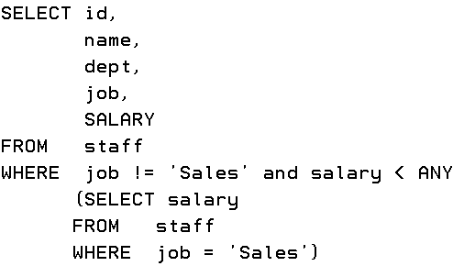
Subqueries – Multi Row Subqueries

Slide 25
Subqueries – Multi Row Subqueries
PROBLEM: Display employees with a salary less than people with sales job
Looking at the outer query, the result shows employees who are not in sales and whose salary is less than ANY salary that is returned by the inner subquery
The inner subquery sends back all the salaries for job equal to sales.
Since the outer query is looking for a salary less than ANY of the sales salaries then it is looking for a value that is less than the maximum value returned by the inner Subquery.
There are a variety of combinations using IN, ANY and ALL which would provide a result set that you are looking for.

Slide 26
Subqueries – Multi Row Subqueries
IN – Equal to any member in the list
ANY – Compare value to each value returned by the subquery
ALL – Compare value to every value returned by the subquery
> ALL -- greater than all means more than the maximum
< ALL -- less than all means less than the minimum
NOT – can be used to produce the “opposite” results for any of the above

Slide 27
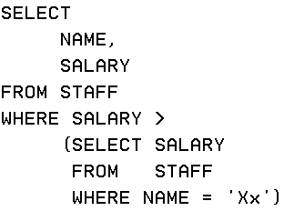

Subqueries – Null results
PROBLEM: Who earns more money than Xx ?
This is OK. You will just receive an empty result set.

Slide 28
Subqueries – Multi-Column Results
A multiple-column subquery returns more than one column to the outer query
The multiple-column subquery can be listed in the outer query’s
FROM clause
WHERE clause
HAVING clause

Slide 29
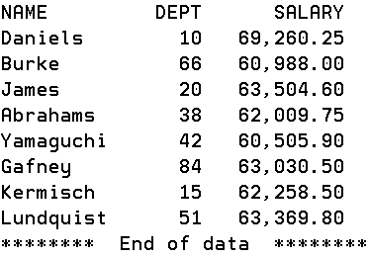
Subqueries – Multi-Column Results
PROBLEM: Show the employee or employees in each department whose current salary is the lowest (or minimum) salary in the department.

Slide 30
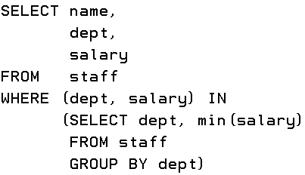
Subqueries – Multi-Column Results
PROBLEM: Show the employee or employees in each department whose current salary is the lowest (or minimum) salary in the department.

Slide 31
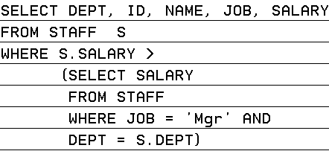
Subqueries
PROBLEM: Provide details on employees who earn more than their manager ?

Slide 32
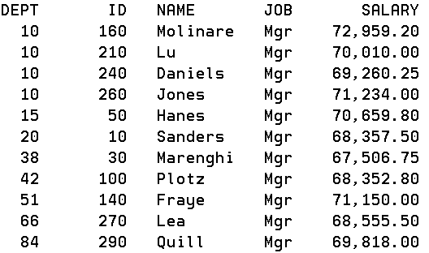
Subqueries
Check managers

Slide 33
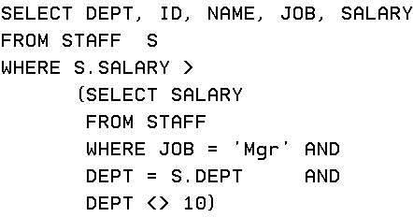
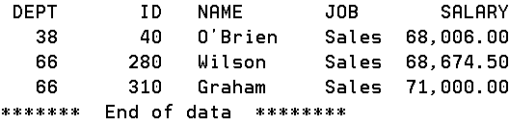
Employees who earn more than their managers
Notice in this case we need to have a WHERE clause predicate which references the outer STAFF column value

Slide 34
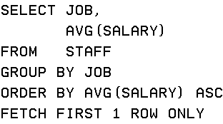

Subqueries
PROBLEM: Find the job with the lowest average salary. Display the job ID and that average salary.
Sometimes there are simpler approaches than sub-selects
Using DESC instead would give you the highest average salary job

Slide 35
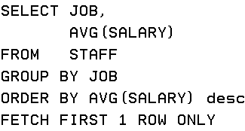

Subqueries
PROBLEM: Find the job with the highest average salary. Display the job ID and that average salary.

Slide 36
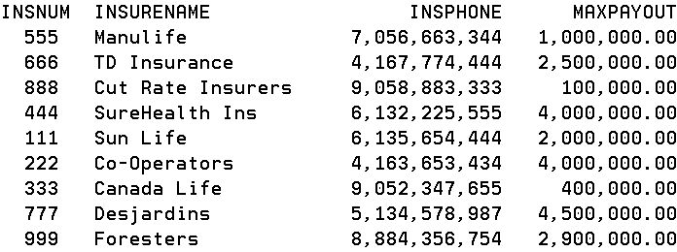
INSURANCE3
A few more companies were added to INSURANCE3

Slide 37
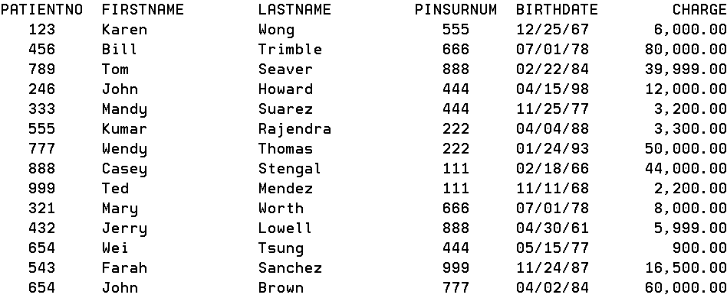
PATIENT3
A few more patients were added to PATIENT3 (A complete list shows on a blackboard handout)

Slide 38
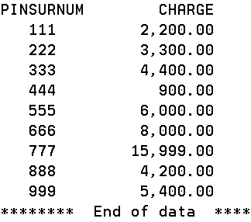
Problem
Show the minimum payout each insurance company made to all the patients.

Slide 39
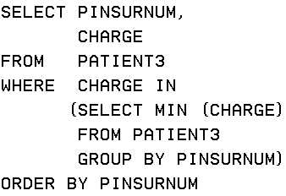
Problem
Show the minimum payout each insurance company made to all the patients.

Slide 40
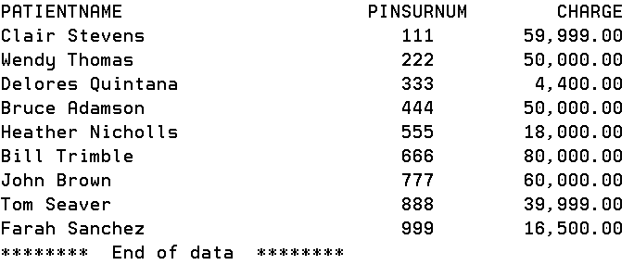
Problem
What is the maximum payout each insurance company made to all the pateints and who was the patient that got that maximum payout?

Slide 41
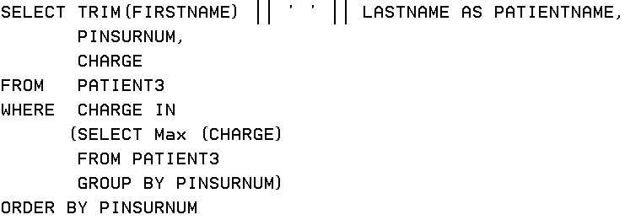
Including the name

Slide 42
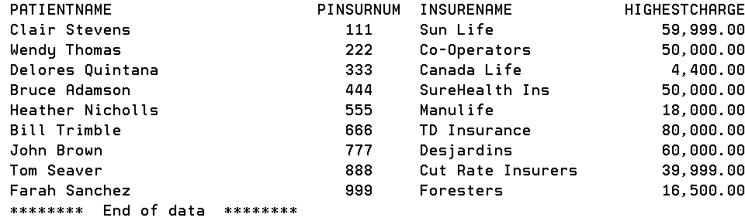
Problem
Can you include the insurance company name in your result set?

Slide 43
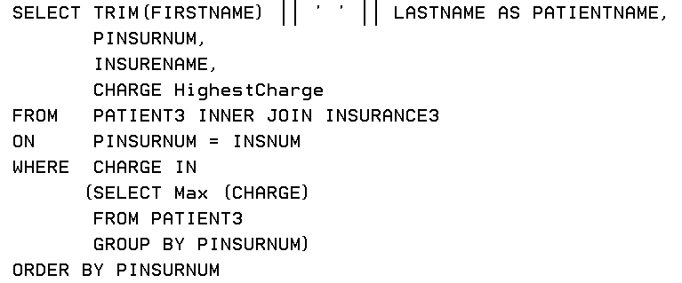
Including the company name

Slide 44
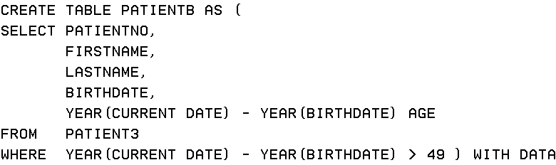
Subqueries
Is the Select statement the only statement that can use a subquery?
You want to have a separate table for anyone older than 49 and you don’t want to keep the charge amount
less rows and less columns in new table

Slide 45
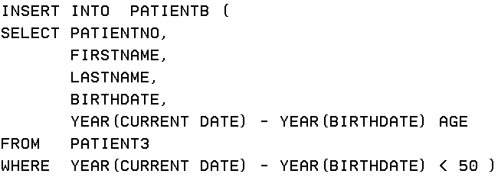
Subqueries
Now you want to include the younger patients as well in this new table

Slide 46

Subqueries
Remove the patients who are within five years of the oldest patient

Slide 47
Lab 3
Lab 3 for Friday already available and Lecture 4 Powerpoint will be uploaded sometime tonight.
Assignment 1 is up. It is due on Thursday Feb 23 at 9:00 AM

